Slide 1
P.A.R.C
Proximity: Related items should be grouped close together. This provides the viewer
with a visual cue that this items are similar and should be treated as a group.
Alignment: Every visual element on a page should have some kind of connection
to at least one other element. Nothing should be positioned haphazardly.
Repetition: Common elements, such as colors, graphics, layout styles, and so on,
should be repeated to give a consistent look and feel to a page.
Contrast: The idea of contrast is to make dis-similar elements very different.
Contrast is one of the most powerful visual design tools.

Slide 2
Proximity
Proximity is about moving things closer or farther apart to achieve a more organized look.
Related items should be grouped together so that they will be viewed as a group.
Audiences will assume that items not near each other are not closely related.
Audiences will naturally tend to group similar items that are near.
Be conscious of where our eye goes first!
When you look at your web page notice where your eye is drawn first, second, .etc.
What path does your eye take?

Slide 3
Proximity
Consider: Sample Business card with five elements
Steve Smith (801) 345-1244
Web Designer
125 E. Center St. Rexburg, ID
Where do you begin reading? In the middle? Where does your eye go next?
Items on the card seem unrelated, and it is not clear when you have read all the information!

Slide 4
Proximity
Consider the same elements grouped in closer proximity.
Web Designer
Steve Smith
125 E. Center St.
Rexburg, ID
(801) 345-1244

Slide 5
Proximity
Summary of proximity
Grouping related elements together into closer proximity automatically creates organization.
Count the number of visual elements. Can these elements be grouped together into closer proximity to become one visual unit?
What to avoid:
too many separate elements on a page.
sticking things in corners and the middle.
leaving equal amounts of white space between elements unless each group is part of a subset.
avoid confusion over whether an element belongs with its related material.
don't create a relationship where there is none!

Slide 6
Repetition
Repeating something again and again can have a strong affect on people.
In visual design, repeating something, a font weight, an image, a set of colors, etc., gives consistency to the page.
Alignment as a kind of repetition: when you align two text elements, you are "repeating" the use of the same margin or spacing.

Slide 7
Repetition
Use the same font styles for headers. For less important header, make the font smaller in a systematic way, but retain the other font properties (s.a. family and weight).
Put page numbers, footnotes, bars, etc. in the same style and place on each page.
Use drawings (or parts of them) and repeat its visual style to have a unique and consistent look. Logos are another good example of repetition: good logos are eye-catching, but also not disruptive so they can be repeated all over the place.

Slide 8
Repetition
In this example, the strong bold typeface from the card holder's name is repeated in the phone number.
The intention is for the eye not to wander off the page once it gets to the bottom.
Web Designer
Steve Smith
125 E. Center St.
Rexburg, ID
(801) 345-1244
Repeating the font at the end of the card causes your eye to wander back to the beginning.

Slide 9
Alignment
Alignment allows us to make conscious decisions about how and where elements are placed on the page.
Alignment develops order and order conveys harmony.
Proper alignment means nothing on your web page should look as if it were placed there randomly.
Even elements that are quite far apart on a page should have a visual connection, something that is easier to achieve with the use of grids.

Slide 10
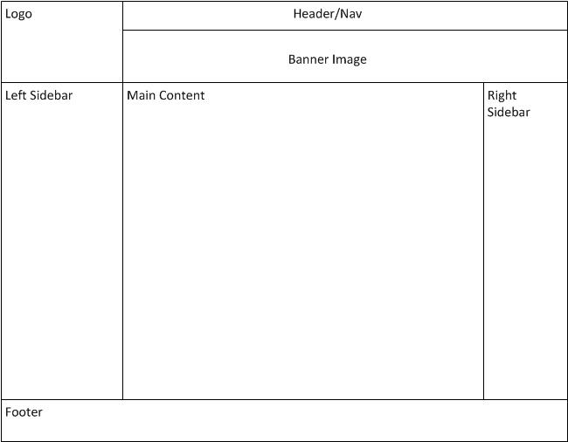
Alignment
Notice: Text is left aligned for the logo, left sidebar, main content, right sidebar and footer sections. The header/navigation and banner image area the alignment is centered. This is just one example of how web page elements can be consciously aligned on a grid or guideline system.

Slide 11
Grid-View Layouts – Responsive Web Design
Many web pages are based on a grid-view, which means that the page is divided into columns:
Using a grid-view is very helpful when designing web pages. It makes it easier to place elements on the page.
A responsive grid-view often has 12 columns, and has a total width of 100%, and will shrink and expand as you resize the browser window.

Slide 12
Grid-View 12 Column
Example: 12ColGridView.html
The following web page sample2Col.html uses the 12 column grid design
and contains:
A <header> tag not in the 12 column grid.
A <div> representing a single row with 2 columns.
The two columns in the row are 2 nested <div> tags.
The 1st <div> represents the first column and spans 3 columns of the 12 column grid.
The 2nd <div> represents the second column 2 and spans 9 columns of the 12 column grid.
<footer> a single row - which spans all 12 columns of the 12 column grid.

Slide 13
CSS Flexible Box Layout (FlexBox)
Flexible boxes, or flexbox, is a new layout mode in CSS3.
Use of flexbox ensures that elements behave predictably when the page layout must accommodate different screen sizes and different display devices.
A flexbox consists of “flex containers” and “flex items”.
A flex container is declared by setting the display property of an element to either flex (rendered as a block) or inline-flex (rendered as inline).
Inside a “flex container” there is one or more “flex items”.
Note: Everything outside a flex container and inside a flex item is rendered as usual. Flexbox defines how flex items are laid out inside a flex container.

Slide 14
Flex containers and Flex items - example
<!DOCTYPE html>
<html>
<head>
<style>
.flex-container {
display: flex;
width: 400px;
height: 250px;
background-color: lightgrey;
}
.flex-item {
background-color: blue;
width: 100px;
height: 100px;
margin: 10px;
}
</style>
</head>
<body>
<div class="flex-container">
<div class="flex-item">flex item 1</div>
<div class="flex-item">flex item 2</div>
<div class="flex-item">flex item 3</div>
</div>
</body>
</html>
https://www.w3schools.com/css/tryit.asp?filename=trycss3_flexbox_flexline

Slide 15
Contrast
Contrast

Slide 16
Why is Contrast important?
Contrast allows you to emphasize or highlight key elements in your design.
Making use of contrast can help you create a design in which one item is clearly dominant.
If all items in a design are of equal or similar weight with weak contrast and with nothing being clearly dominant, it is difficult for the viewer to know where to begin.
Designs with strong contrast attract interest, and help the viewer make sense of the visual.
Weak contrast is not only boring, but it can be confusing.

Slide 17
Implementing Contrast
Bigger fonts (e.g. for section headings) contrast with smaller fonts.
Font weight (i.e. boldness) contrasts with fonts of the same size but different weight.
Color can make strong contrasts: compare black text on a white background to white text on a black background.
Horizontal lines (real, or invisible alignment lines) versus vertical lines. For example, most text is written horizontally, so vertical text is a strong contrast.
Big pictures versus small pictures.
The spacing between lines and letters: more tightly spaced text contrasts with more loosely spaced text.

Slide 18
Contrast – examples and resources
http://www.presentationzen.com/chapter6_spread.pdf

